Slide 1



DUPLICATE FILE REMOVER
Efficiently Clean Your Storage
Group Details:
Roll No. | Name
71229 | Shaikh Sohail Chand
71226 | Shinde Pratik Chandrakant
71228 | Rasal Dipak Barku
Date : 22/03/2025
Frontend Code Overview
HOME PAGE
Introduction
How It Works
Frontend Code Overview
JSON Data
ER-Diagram
Key Features
Benefits
Future Enhancements
Conclusion

Slide 2


What is Duplicate File Remover?
- A tool to identify and remove duplicate files from a computer
or storage device.
- Helps free up disk space by deleting unnecessary duplicate files.
- Improves system performance and organization.
- Features :
- Scan folders for duplicates.
- Delete duplicates with a single click.
- Save deletion history in JSON format.
HOME PAGE
Introduction
How It Works
Frontend Code Overview
JSON Data
ER-Diagram
Key Features
Benefits
Future Enhancements
Conclusion

Slide 3
How It Works?
Select Folder: Choose the directory to scan.
Scan for Duplicates: The tool identifies files with identical content.
Review Results: View a list of duplicate files.
Delete Duplicates: Remove duplicates with confirmation.
Save History: Deletion details are saved in a JSON file.
PREVIEW
HOME PAGE
Introduction
How It Works
Frontend Code Overview
JSON Data
ER-Diagram
Key Features
Benefits
Future Enhancements
Conclusion

Slide 4
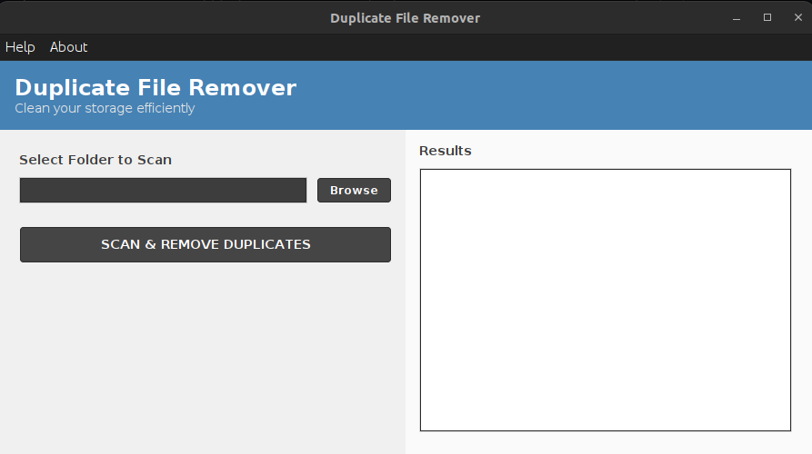
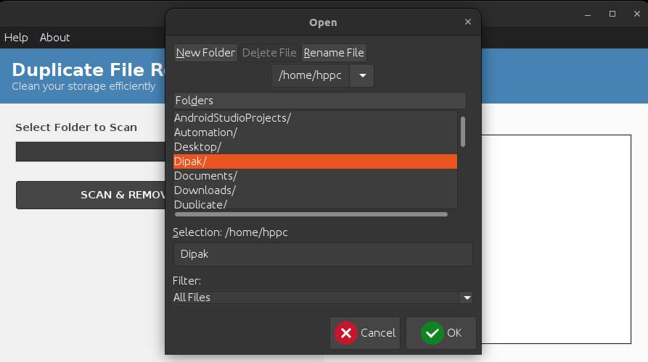
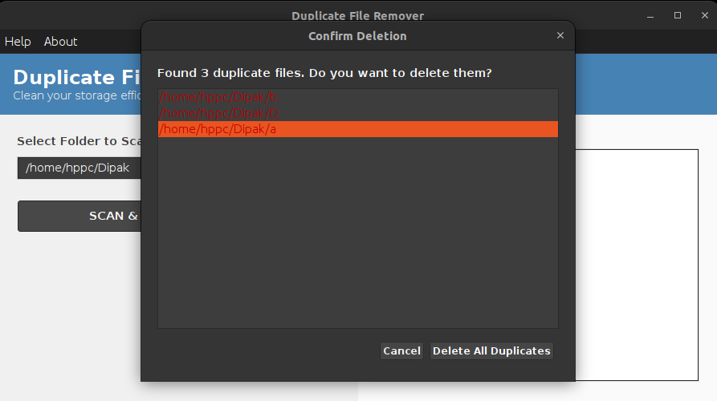
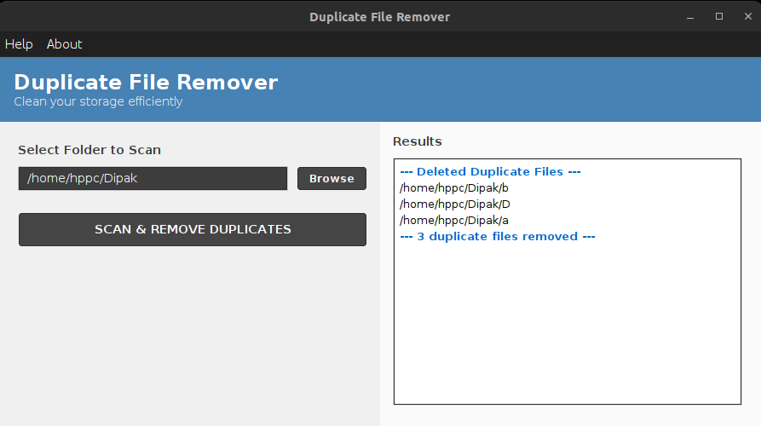
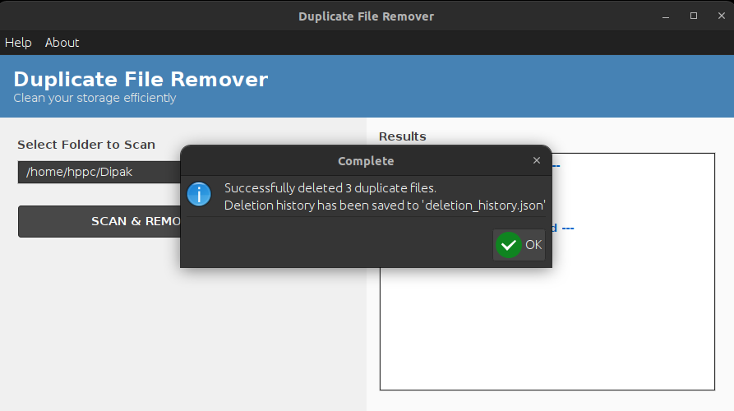
How It Works?
Open : Application
Select Folder:
Choose the directory to scan.
Review Results:
View a list of duplicate files and Confirmation.
Save History :
Deletion details are saved in a JSON file.
Delete Duplicates :
Remove Duplicates Files Successfully.
HOME PAGE
Introduction
How It Works
Frontend Code Overview
JSON Data
ER-Diagram
Key Features
Benefits
Future Enhancements
Conclusion

Slide 5

Open : Application

Slide 6
Select Folder: Choose the Directory to scan.

Slide 7
Review Results: View a list of duplicate files and Confirmation.

Slide 8
Delete Duplicates : Remove Duplicates Files Successfully.

Slide 9
Save History : Deletion details are saved in a JSON file.

Slide 10
Frontend Code (Java Swing)
- Built using Java Swing for a desktop application.
- Features :
- Splash screen with progress bar.
- System tray integration.
- Intuitive UI with buttons and lists.
- Customizable color themes.
PREVIEW
HOME PAGE
Introduction
How It Works
Frontend Code Overview
JSON Data
ER-Diagram
Key Features
Benefits
Future Enhancements
Conclusion

Slide 11
Data Saved in JSON Format
- Handles structured data efficiently, including storing and managing deletion
history to track changes, recover lost data, and ensure auditability.
- Fields :
- path: File path.
- name : File name.
- deleted_at : Timestamp of deletion
EXAMPLE
PREVIEW
HOME PAGE
Introduction
How It Works
Frontend Code Overview
JSON Data
ER-Diagram
Key Features
Benefits
Future Enhancements
Conclusion

Slide 12

Data saved
In JSON
FORMAT

Slide 13
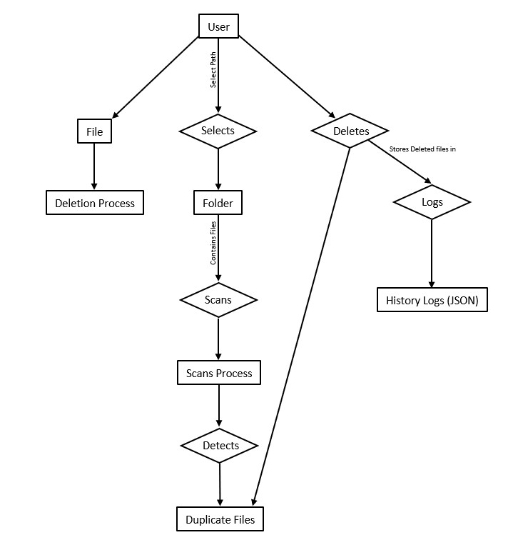
ER - Diagram
HOME PAGE
Introduction
How It Works
Frontend Code Overview
JSON Data
ER-Diagram
Key Features
Benefits
Future Enhancements
Conclusion

Slide 14
Key Features
- Cross-Platform : Works on desktop Application
- User-Friendly : Simple and intuitive interface.
- Efficient : Quickly scans and removes duplicates.
- History Tracking : Saves deletion details in JSON format.
- Smart Detection : Check file content(not just names)
HOME PAGE
Introduction
How It Works
Frontend Code Overview
JSON Data
Key Features
Benefits
Future Enhancements
Conclusion

Slide 15
Benefits of Using Duplicate
File Remover
- Frees up disk space.
- Improves system performance.
- Reduces clutter and organizes files.
- Saves time with automated scanning and deletion.
HOME PAGE
Introduction
How It Works
Frontend Code Overview
JSON Data
Key Features
Benefits
Future Enhancements
Conclusion

Slide 16
Future Enhancements
- Cloud integration (e.g., Google Drive, Dropbox).
- Advanced filters (e.g., by file type, size).
- Multi-language support.
- Mobile app version.
HOME PAGE
Introduction
How It Works
Frontend Code Overview
JSON Data
Key Features
Benefits
Future Enhancements
Conclusion

Slide 17
Conclusion
- Duplicate File Remover is a powerful tool for managing storage.
- Available as a desktop application and web interface.
- Try it today to optimize your system!
HOME PAGE
Introduction
How It Works
Frontend Code Overview
JSON Data
Key Features
Benefits
Future Enhancements
Conclusion

